Slide 1

Mechanical Analysis of Sustainably Derived Resins & Individual Natural Fibers for SUstainable Manufacturing of AirCraft (SUMAC) Composites
Intern
Enoch Kim
University of California Irvine – Aerospace Engineering
Mentors
Dr. Sang-Hyon Chu & Dr. Cheol Park
2025 Spring Student Research Symposium
Advanced Materials and Processing Branch
NASA Langley Research Center

Slide 2

Challenge
Aircraft industry uses tons of carbon composites
Commonly made with thermoset resins
Not recyclable or repairable
Discarded once expended
Negative environmental impact
Poor and slow biodegradability
Releases pollution when degrading
Aircraft engine and fuel efficiency have been optimized for sustainability
Limited research has been done for recycling the aircraft
Sustainable aircraft composites is a new and growing field
Little precedent or past research compared to other common composites (carbon fibers, glass fibers, and epoxies)
Pale Blue Dot Pale Blue Dot Revisited | NASA Image and Video Library
We only have one home, for now, lets take care of it.
Notes:
Voyager
Pale blue dot, talk about it

Slide 3
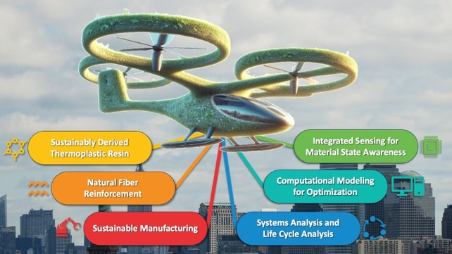


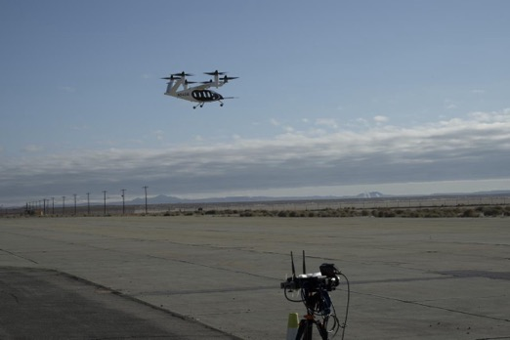
Objective
SUMAC’s Objectives:
SUstainable Manufacturing of Aircraft (SUMAC)’s objectives:
Develop sustainably derived thermoplastic composite technologies for future aviation
Advanced air mobility (AAM) vehicles
Advance the sustainable manufacturing of aircraft in six key focus areas
Enoch’s objective:
Characterize the mechanical properties of various natural fibers and thermoplastic resins
EnviroTextiles Hemp Fibers
BComp Flax Fibers & A&P Braided Flax Fibers
Mango Materials Polyhydroxy Butyrate (PHB)
Pond Polylatic Acid (PLA)
Arkema Rilsan/Polyamide 11 (PA-11)
Assist sensing and modeling team at Ames Research Center (ARC) to create accurate computation natural composite models
What this means for SUMAC:
Set a precedent for natural composite properties and researching methods
Identify the best materials for sustainable composites
SUMAC Composites
AAM
Commercial Aircraft
Joby Aviation AAM NASA and Joby Research Near NASA’s Armstrong Flight Research Center | NASA Image and Video Library
Notes:
Sustainably Derived Thermoplastic Resin
Natural Fiber Reinforcement
Sustainable Manufacturing
Integrated Sensing for Material State Awareness
Computational Modeling for Optimization
Systems Analysis and Life Cycle Analysis
Sumac → AAM → eventually commmerical aircraft

Slide 4
Approach
Mechanical Testing on Natural Fibers and Biodegradable Thermoplastic Resins
Develop procedure for tensile testing individual natural fibers
Crucial for characterization of the strongest natural fibers
Procedure is transferable to non natural fibers as well
The experimental data are fed into computational models to improve simulation capabilities and reduce time and cost
Image Segmentation and Analysis
Additional characterization of natural materials
Notes:
Mechanical testing and develop a procedure for individual fibers
Image segmentation for computational modeling

Slide 5
Mechanical Testing of Individual Natural Fibers

Slide 6
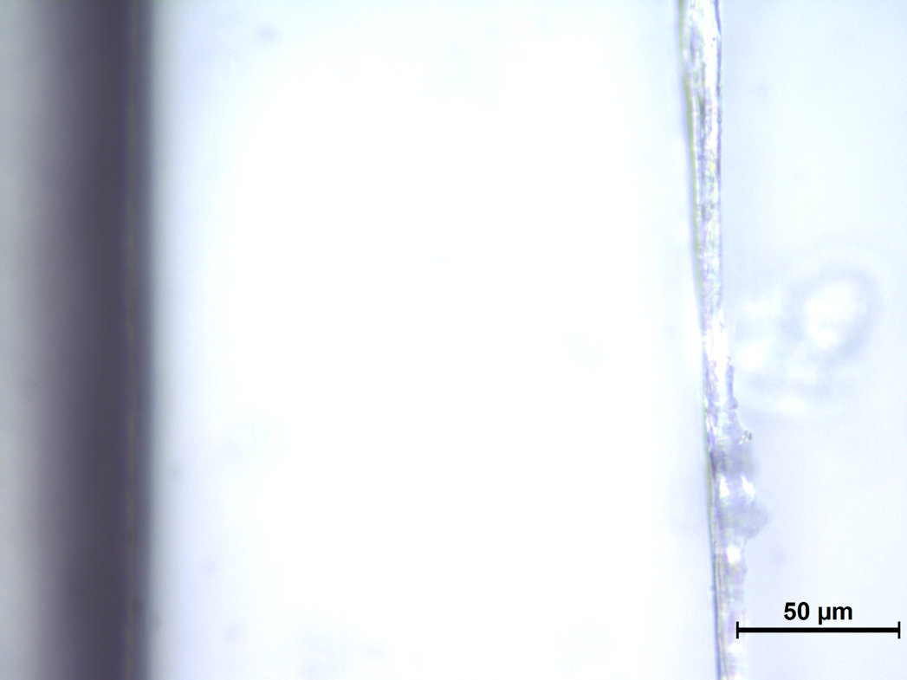
A Closer Look at Natural Fibers
On the right is one of SUMAC’s individual natural fibers, specifically it’s semi bleached Hemp B608 from the company EnviroTextiles. Key characteristics to notice are its inconsistent shape and diameter.
Optical Microscope 50x
Notes:
The white object on the right is Envirotextles HEMP B608

Slide 7
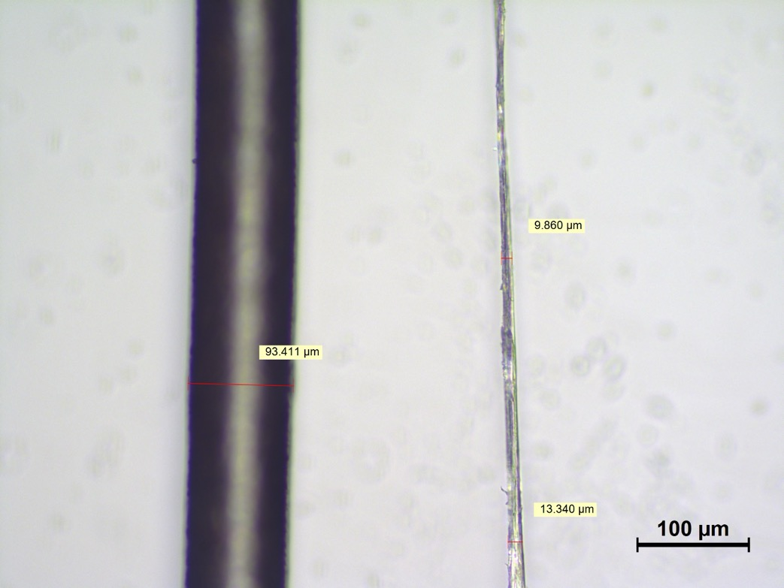
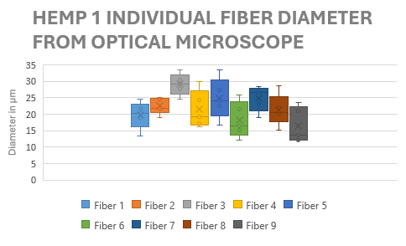
A Closer Look at Natural Fibers
And the black object on the left is my hair… Individual natural fibers are extremely small. Ranging from 10-30 µm.
In addition to being small, they vary greatly in diameter making them a challenge to characterize.
Enoch’s Hair
EnviroTextiles Hemp B608
Optical Microscope 20x

Slide 8
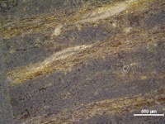
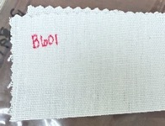
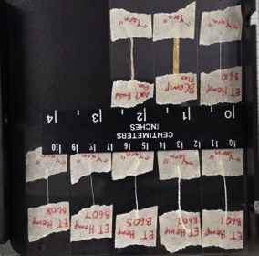
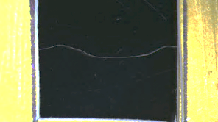
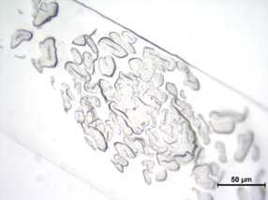
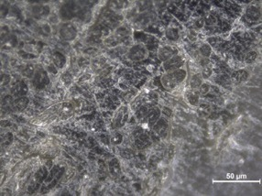
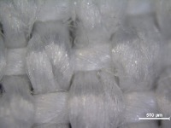
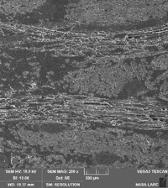
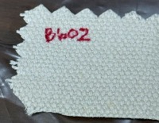
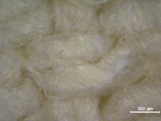
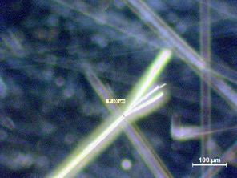
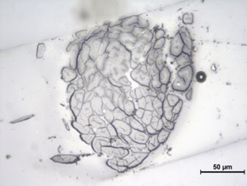
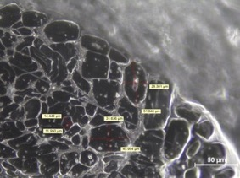
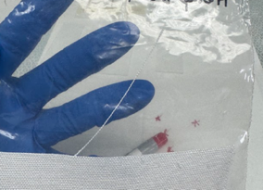
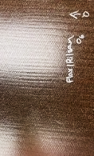
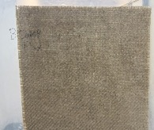
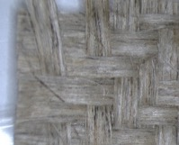
A Closer Look at Natural Fibers
Composites
Fabrics
Yarns
Individual Fibers
Fiber Cross Sections
Optical Microscope 5x
Hemp B601
Optical Microscope 5x
TESCAN SEM
Hemp B602
Optical Microscope 5x
BComp Flax, Stereo Microscope
Hemp B608 Optical Microscope 50x
BComp Flax Optical Microscope 50x
BComp Flax
Stereo Microscope
BComp Flax, Optical Microscope 20x
Hemp B610 Optical Microscope 50x
Hemp B605 Optical Microscope 50x
SUMAC composite A&P Flax Rilsan
Hemp B601
Notes:
Composite sample, you can see the thermoplastic resin interfacing with the flax fibers
Warp and weft direction
Cross section images, you can see the bundle or fibers

Slide 9
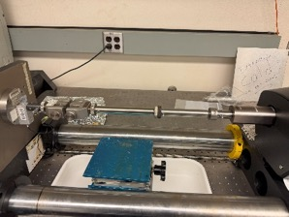
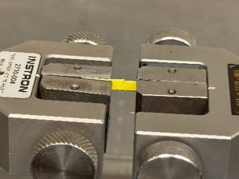
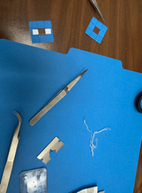
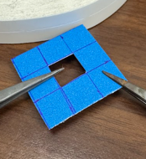
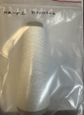
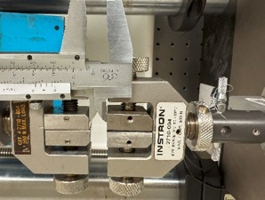
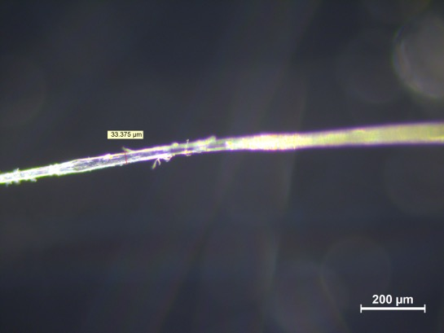
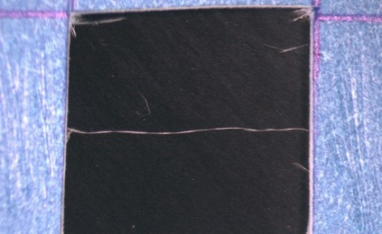
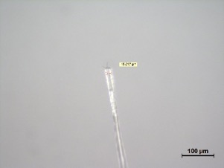
Individual Natural Fiber Tensile Testing Procedure
Some of the challenges I faced which warranted creating this procedure were:
Handling such small fibers
Separating bundles & yarn into individual fibers
Gripping individual fibers for tensile testing
Instron 5848 with 5N load Cell and extension arms used for fragile sample, natural fibers.
Coupon/paper with individual fiber cut right before tensile testing to put load on the fiber.
Individual Fiber Separation and Preparation for Tensile Testing
Gauge length measured after preload is applied to the fiber, for most accurate ramp rate, gauge length, and eliminating slack.
Fiber
Finally, the most crucial part, measure the diameter where fracture occurred. This gives an accurate cross-sectional area for the strength calculation. This is necessary since natural fiber diameters vary so much.
Stereo Microscope
Optical Microscope 10x, Hemp 1 Fiber No. 5
Optical Microscope 5x
Optical Microscope 20x

Slide 10
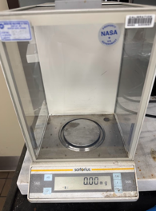

Natural Fiber Mechanical Properties
I charactered many individual fibers and yarn
Identified the most favorable mechanical characteristics
Tensile Strength, % Elongation at Break, Modulus, Force/Linear Density, and Toughness
Yarn Sample & Notes | Force/LinearDensity (N/tex) [N/(kg/m)] | % Elongation at Break | Young’s Modulus (GPa) | Linear Density (tex) 1 tex = 1 gram/km | Tensile Strength (MPa) Diameter is subjective, approximate
BComp Flax Yarn | 0.172 ± 0.012 [172238 ± 19657] | 1.5 ± 0.1 | 12.0 ± 1.7 | 273.0 ± 77.4 | 143.2 ± 23.0
A&P “Braided/Woven” Flax Yarn | 0.082 0.031 [82342 ± 30739] | 1.4 ± 0.4 | 4.3 ± 1.4 | 171.8 ± 91.6 | 45.5 ± 19.5
“Hemp” 1 Yarn | Not assessed, unknown fiber origin, decided not to proceed | 4.5 ± 0.9 | 7.51 ± 3.3 | Not assessed, unknown fiber origin, decided not to proceed | 259.7 ± 32.8
“Hemp” 2 Yarn | Not assessed, unknown fiber origin, decided not to proceed | 4.9 ± 1.1 | 7.19 ± 3.6 | Not assessed, unknown fiber origin, decided not to proceed | 253.8 ± 134.8
“Hemp” 3 Yarn | Not assessed, unknown fiber origin, decided not to proceed | 13.1 ± 8.3 | 5.08 ± 2.5 | Not assessed, unknown fiber origin, decided not to proceed | 228.8 ± 80.7
EnviroTexiles Hemp B601 Yarn | 0.215 ± 0.021 [214686 ± 20611] | 6.1 ± 0.7 | 7.1 ± 1.3 | 148.0 ± 23.4 | 329.0 ± 54.5
EnviroTexiles Hemp B602 Yarn | 0.071 ± 0.012 [70668 ± 11918] | 10.1 ± 1.6 | 1.0. ± 0.2 | 267.0 ± 13.5 | 73.1 ± 15.8
EnviroTexiles Hemp B605 Yarn | 0.207 ± 0.050 [207062 ± 49517] | 7.5 ± 1.2 | 3.6 ± 1.0 | 82.8 ± 46.3 | 198.9 ± 33.1
EnviroTexiles Hemp B607 Yarn | 0.222 ± 0.023 [222045 ± 23066] | 9.25 ± 1.4 | 5.3 ± 0.9 | 55.6 ± 11.4 | 381.5 ± 67.2
EnviroTexiles Hemp B608 Yarn | 0.284 ± 0.028 [284286 ± 28314] | 6.7 ± 1.2 | 6.1 ± 1.0 | 26.0 ± 4.3 | 343.7 ± 38.3
EnviroTexiles Hemp B610 Yarn | 0.230 ± 0.051 [230273 ± 51278] | 5.7 ± 1.3 | 8.7 ± 3.6 | 24.5 ± 7.3 | 310.7 ± 103.7
EnviroTexiles 100% Hemp Yarn | 0.295 ± 0.340 [295023 ± 33508] | 4.1 ± 0.8 | 10.3 ± 2.1 | 32.4 ± 13.2 | 378.0 ± 101.4
Individual Fiber Sample & Notes | Tensile Strength (MPa) | % Elongation at Break | Young’s Modulus (GPa)
ET Hemp B608 | 800.4 ± 366.4 | 3.0 ± 0.4 | 35.1 ± 1.7
BComp Flax | 880.2 ± 596.3 | 2.4 ± 0.8 | 42.1 ± 21.7
Hemp 1(Bleached) | 518.1 ± 318.3 | 3.0 ± 0.4 | 20.7 ± 11.3
A&P Braided Flax | 906 ± 768.5 | 2.0 ± 1.0 | 52.9 ± 27.2
ET Hemp B607 | 492.6 ± 233.6 | 4.4 ± 1.5 | 15.8 ± 4.3
ET 100% Hemp twill | 1238.5 ± 719.1 | 3.2 ± 0.8 | 47.5 ± 22.1
Literature Hemp | ~500-900 | ~1.2-3.5 | ~60
Literature Flax | ~340-1500 | ~1.2-3.2 | ~30-80
Scale used to calculate linear density.
$$tex=\frac{grams}{km}$$
Note: Yarn’s Tensile Strength is only a ballpark value. Measuring diameters for yarn is highly subjective. Force/linear density (tex) is better for yarns.

Slide 11
Natural Fiber Mechanical Properties
I charactered many individual fibers and yarn
Identified the most favorable mechanical characteristics
Tensile Strength, % Elongation at Break, Modulus, Force/Linear Density, and Toughness
Yarn Sample & Notes | Force/LinearDensity (N/tex) [N/(kg/m)] | % Elongation at Break | Young’s Modulus (GPa) | Linear Density (tex) 1 tex = 1 gram/km | Tensile Strength (MPa) Diameter is subjective, approximate
BComp Flax Yarn | 0.172 ± 0.012 [172238 ± 19657] | 1.5 ± 0.1 | 12.0 ± 1.7 | 273.0 ± 77.4 | 143.2 ± 23.0
A&P “Braided/Woven” Flax Yarn | 0.082 0.031 [82342 ± 30739] | 1.4 ± 0.4 | 4.3 ± 1.4 | 171.8 ± 91.6 | 45.5 ± 19.5
“Hemp” 1 Yarn | Not assessed, unknown fiber origin, decided not to proceed | 4.5 ± 0.9 | 7.51 ± 3.3 | Not assessed, unknown fiber origin, decided not to proceed | 259.7 ± 32.8
“Hemp” 2 Yarn | Not assessed, unknown fiber origin, decided not to proceed | 4.9 ± 1.1 | 7.19 ± 3.6 | Not assessed, unknown fiber origin, decided not to proceed | 253.8 ± 134.8
“Hemp” 3 Yarn | Not assessed, unknown fiber origin, decided not to proceed | 13.1 ± 8.3 | 5.08 ± 2.5 | Not assessed, unknown fiber origin, decided not to proceed | 228.8 ± 80.7
EnviroTexiles Hemp B601 Yarn | 0.215 ± 0.021 [214686 ± 20611] | 6.1 ± 0.7 | 7.1 ± 1.3 | 148.0 ± 23.4 | 329.0 ± 54.5
EnviroTexiles Hemp B602 Yarn | 0.071 ± 0.012 [70668 ± 11918] | 10.1 ± 1.6 | 1.0. ± 0.2 | 267.0 ± 13.5 | 73.1 ± 15.8
EnviroTexiles Hemp B605 Yarn | 0.207 ± 0.050 [207062 ± 49517] | 7.5 ± 1.2 | 3.6 ± 1.0 | 82.8 ± 46.3 | 198.9 ± 33.1
EnviroTexiles Hemp B607 Yarn | 0.222 ± 0.023 [222045 ± 23066] | 9.25 ± 1.4 | 5.3 ± 0.9 | 55.6 ± 11.4 | 381.5 ± 67.2
EnviroTexiles Hemp B608 Yarn | 0.284 ± 0.028 [284286 ± 28314] | 6.7 ± 1.2 | 6.1 ± 1.0 | 26.0 ± 4.3 | 343.7 ± 38.3
EnviroTexiles Hemp B610 Yarn | 0.230 ± 0.051 [230273 ± 51278] | 5.7 ± 1.3 | 8.7 ± 3.6 | 24.5 ± 7.3 | 310.7 ± 103.7
EnviroTexiles 100% Hemp Yarn | 0.295 ± 0.340 [295023 ± 33508] | 4.1 ± 0.8 | 10.3 ± 2.1 | 32.4 ± 13.2 | 378.0 ± 101.4
Number of Samples Tensile Tested
128 Individual Fibers, 134 Yarns
Totaling:
Individual Fiber Sample & Notes | Tensile Strength (MPa) | % Elongation at Break | Young’s Modulus (GPa)
ET Hemp B608 | 800.4 ± 366.4 | 3.0 ± 0.4 | 35.1 ± 1.7
BComp Flax | 880.2 ± 596.3 | 2.4 ± 0.8 | 42.1 ± 21.7
Hemp 1(Bleached) | 518.1 ± 318.3 | 3.0 ± 0.4 | 20.7 ± 11.3
A&P Braided Flax | 906 ± 768.5 | 2.0 ± 1.0 | 52.9 ± 27.2
ET Hemp B607 | 492.6 ± 233.6 | 4.4 ± 1.5 | 15.8 ± 4.3
ET 100% Hemp twill | 1238.5 ± 719.1 | 3.2 ± 0.8 | 47.5 ± 22.1
Literature Hemp | ~500-900 | ~1.2-3.5 | ~60
Literature Flax | ~340-1500 | ~1.2-3.2 | ~30-80
262 samples
Scale used to calculate linear density.
$$tex=\frac{grams}{km}$$
Note: Yarn’s Tensile Strength is only a ballpark value. Measuring diameters for yarn is highly subjective. Force/linear density (tex) is better for yarns.

Slide 12
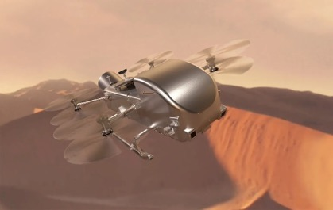

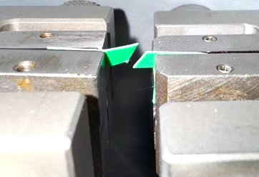
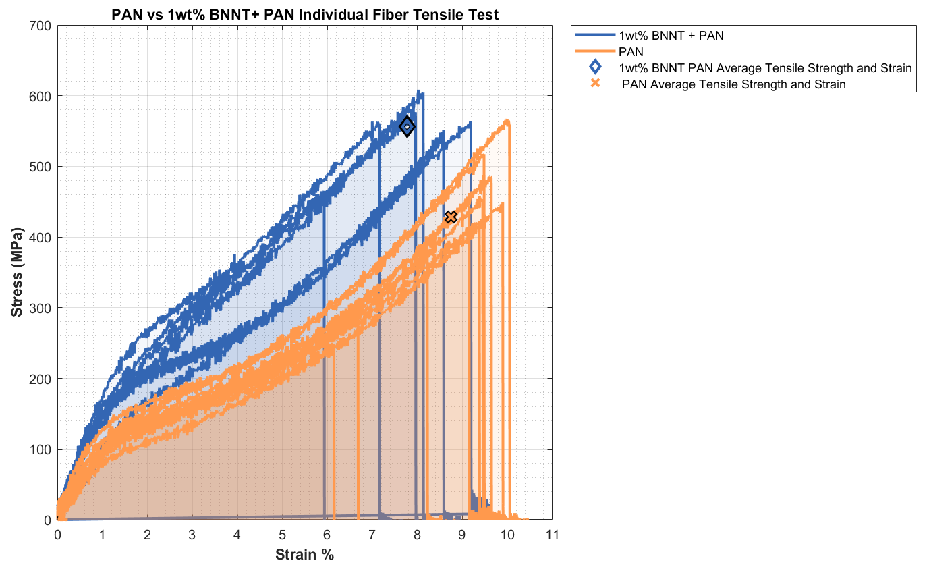
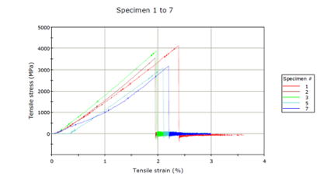
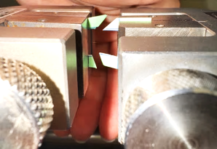
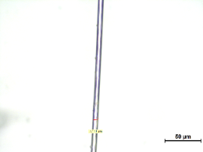
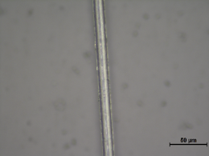
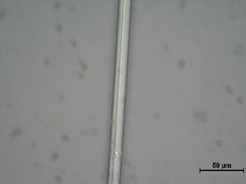
Gaining a Reputation
Through working with SUMAC, I gained a reputation for my technical and procedural capabilities to test individual fibers. Assisted other projects including:
Boron Nitride Nanotube Polyacrylonitrile (PAN) Nanocomposite research
Dragonfly Ablative Carbon Phenolic hybrid yarn & individual fiber for Saturn's moon, Titan
The data from other projects also validated my procedure.
Dragonfly https://www.nasa.gov/news-release/nasa-awards-launch-services-contract-for-dragonfly-mission/
Individual Phenolic/ Kynol Fiber after fracture
Titan and Dione Titan and Dione | NASA Image and Video Library
Individual Fiber Sample | Tensile Strength (MPa) | % Elongation at Break | Young’s Modulus (GPa) | Toughness (MPa)
1wt%BNNT + PAN | 556.1 ± 48.9 | 7.8 ± 1.2 | 12.5 ± 2.4 | 248279.5 ± 40404.1
PAN | 428.3 ± 95.7 | 8.8 ± 1.4 | 7.1 ± 1.3 | 201274.9 ± 58573.8
Individual Carbon Fiber after fracture
Optical Microscope 50x
1wt% BNNT PAN
PAN
Individual Fiber Sample | Tensile Strength (MPa) | % Elongation at Break | Young’s Modulus (GPa)
Carbon Fiber | 3568.2 ± 446.7 | 2.1 ± 0.2 | 205.2 ± 14.0
BNNT PAN seems spikier than the PAN, the edges are more rough
Optical Microscope 50 x
Optical Microscope 50 x

Slide 13
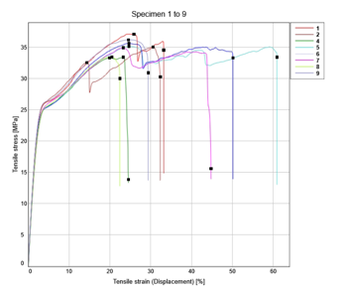
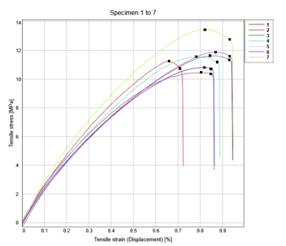
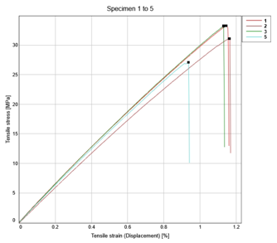
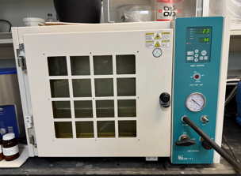
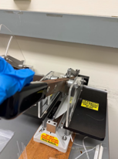
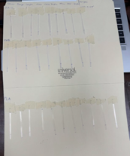
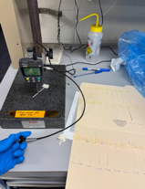



Sustainably Derived Resins Mechanical Properties
Tensile tested sustainably derived resins. Dried samples and non dried samples.
Dried PA-11 had significant lose in elongation at break, while a noticeable increase in Tensile Strength and Modulus
PHB, PLA difference were within standard deviation- drying seems to have very little effect on them
PA-11
PHB
PLA
Polymer Preparation for Tensile Testing Polyamide 11 (PA-11), Polyhydroxy Butyrate (PHB), & Polylatic Acid (PLA)
Polymer Drying Process
Sample: | PA-11 @ RT & Humidity >24hr | Dried PA-11 in -0.08MPa vacuum 25°C for 1 hr | PHB @ RT & Humidity >24hr | Dried PHB in -0.08MPa vacuum 25°C for 1 hr | PLA @ RT & Humidity >24hr | Dried PLA in -0.08MPa vacuum 25°C for 1 hr
Tensile Strength in MPa | 33.5 ± 2.0 | 35.1 ± 1.3 | 14.2 ± 1.6 | 11.6 ± 1.0 | 36.2 ± 4.8 | 31.2 ± 2.9
% Elongation at Break | 154.6 ± 60.5 | 24.7 ± 2.9 | 1.0 ± 0.1 | 0.8 ± 0.1 | 1.3 ± 0.2 | 1.1 ± 0.1
Modulus in GPa | 0.9 ± 0.1 | 1.2 ± 0.1 | 2.5 ± 0.1 | 2.6 ± 0.2 | 3.0 ± 0.2 | 3.2 ± 0.1
Polymers dried using vacuum chamber set to -0.08 MPa and 25°C for 1 hour.
Polymers tested:
Cut film to 3mm width
Image of cut films, stored at room temperature and humidity.
Film thickness measured, used smallest thickness for tensile test cross section
PA-11
PHB
PLA

Slide 14
Image Segmentation & Analysis

Slide 15
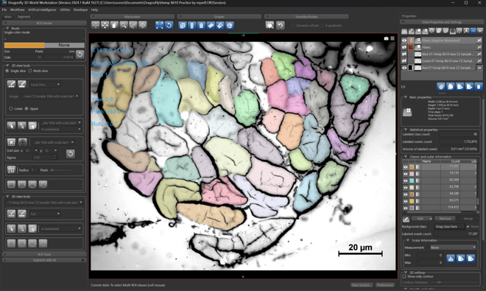
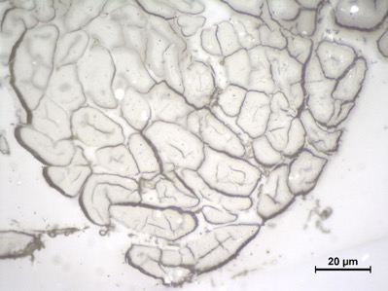
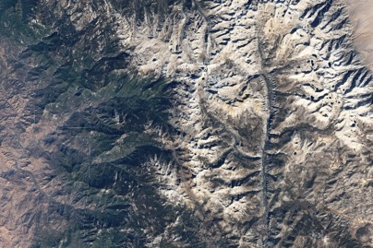


DragonFly Software Image Segmentation
Optical Microscope 100x
Segmentation used to find highly accurate area and diameters of natural fibers
DragonFly’s Software watershed method to segment fibers, EnviroTextiles Hemp B610
Watershed method creates a topographic map of image brightness to segment
Sequoia National Park
https://images.nasa.gov/details/GSFC_20171208_Archive_e000235
Notes:
The watershed transformation treats the image it operates upon like a topographic map, with the brightness of each point representing its height, and finds the lines that run along the tops of ridges.

Slide 16



Yarn Twist Angle Mechanical & Image Analysis
Yarn force/linear density has negative correlation with twist angle
Force at break has positive correlation with with linear density
Hemp B608 Twist angle, Optical Microscope 10x

Slide 17


Results & Analysis
Results
Natural Fibers have large variations in size, shape, cross sectional area, and most properties (mechanical & thermal)
On average flax fibers have a higher tensile strength and modulus than hemp, while hemp has a larger % elongation at break
This trend is not always true, as seen by EnviroTextiles 100% Hemp Twill, ~1200MPa Tensile Strength
Polyamide 11 shows promising mechanical properties
Similar tensile strength to Polylactic Acid when dried
Very ductile, thus absorbs large amounts of energy before fracture (crucial for aircraft materials)
Has lowest modulus out of the three resins
Analysis
Literature reports flax being stronger than hemp, which is has been confirmed from my testing
However, EnviroTextiles 100% Hemp Twill is an exception
Since hemp requires less energy, water, and is space to grow, it is favorable over flax
A hemp fiber potentially stronger than flax is an exciting discovery for SUMAC
EnviroTextiles 100% Hemp Twill Stereo Microscope
EnviroTextiles 100% Hemp Twill Stereo Microscope

Slide 18
Next Steps/Outlook/Future Work
Continue to gather data on new natural fibers and resins
Attempt to decrease standard deviation further
Utilizing image segmentation cross sectional areas for the most accurate tensile strength
Segment Anything Microscopy by Meta for streamlined and accurate image segmentation
Down select the best natural fiber and sustainably derived resin
Create a composite with it, and compare with carbon and glass fiber composites
SUMAC is broadening. Every discovery leads to more questions, there is a big future ahead for SUMAC.

Slide 19




Acknowledgements
Thank you to,
my mentors Dr. Cheol Park and Dr. Sang-Hyon Chu who taught me and assisted me greatly throughout the internship
all the interns I have met and worked with including Jenny Campbell, Jerry Marrero, and Francisco de Jesús especially who also worked on SUMAC.
all faculty and researchers who have helped me: Glen King, Keith Gordon, Jin Ho Kang, Alex Hatfield, Jeffrey Hinkley
NASA’s Office of STEM Engagement and especially Ashley Gonzalez for helping make this opportunity a reality
Hogan Choi for being great roommate & fellow intern
my amazing supportive parents, who helped me experience this great internship
Notes:
Thank you for your time

